Slide 1
Queueing Networks
Shovan Bhowmik
Lecturer
Dept. of cse, baiust

Slide 2
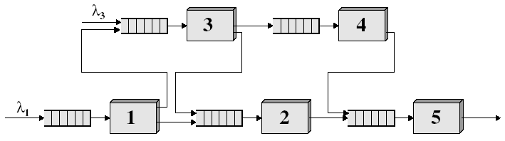
Network of Queues
A queueing network is a system composed of several interconnected stations, each with a queue.
Many communication systems must be modeled as a set of interconnected queues – which is termed a queueing network.
Customers, upon the completion of their service at a station, moves to another station for additional service or leave the system according to some routing rules (deterministic or probabilistic).

Slide 3
Categories of Queueing Networks
Systems modeled by queueing networks can roughly be grouped into four categories:
Open networks
Closed networks
Networks with population constraints (Loss Networks)
Mixed networks

Slide 4
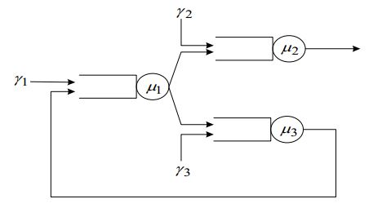
Open Network
Customers arrive from outside of the system are served and then depart.
Example: Packet switched data network

Slide 5
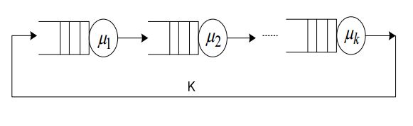
Closed Network
Fixed number of customers (K) are trapped in the system and circulate among the queues.
Example: CPU job scheduling problem

Slide 6
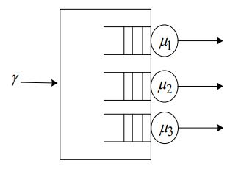
Loss Networks with Population Constraints
Customers arrive from outside of the system if there is room in the system. They enter, served and then depart.
Example: Queues sharing a common buffer pool – customers are lost when arriving to full system

Slide 7
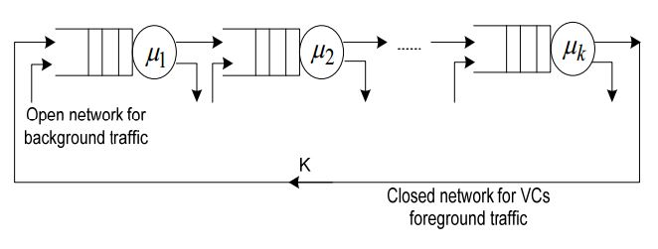
Mixed Networks
Any combination of previous types.
Example: Simple model of virtual circuit that is window flow controlled.

Slide 8
Properties of Queueing Networks
Queueing Networks exhibit behavior not seen in single queue scenarios.
Jockeying: Customers moving among parallel queues.
Blocking: Customer waiting (depart a server and join next queue) is unable due to limited waiting space and therefore stays in server (blocking it.)
Routing: Customer leaving a queue may have options as to where to go next
Forking: Customer leaving a queue clones into multiple customers possibly going along different routes.
Joining: Multiple customers are combined into a single customer
Forking and joining are used in models of parallel processing systems, packet fragmentation and reassembly.

Slide 9
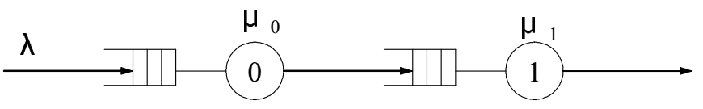
Exponential Queues in Series Networks
In the queuing models that we have studied so far, a customer’s entire service time is spent with a single server.
In many situations the customer’s service is not complete until the customer has been served by more than one server.
2-stage tandem network with Independent Service Times:

Slide 10
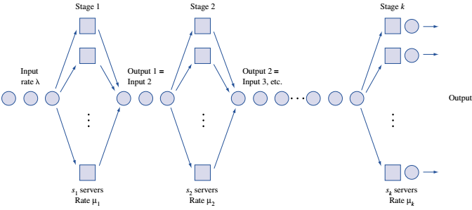
Exponential Queues in Series Networks(Cont..)
K – Stage queueing system:
Streams of arrivals

Slide 11
Exponential Queues in Series Networks(Cont..)
Theorem:
If:
1. inter-arrival times for a series queuing system are exponential with rate λ,
2. service times for each stage i, server are exponential and
3. each stage has an infinite-capacity waiting room
then inter-arrival times for arrivals to each stage of the queuing system are exponential with arrival rate λ.

Slide 12
Exponential Queues in Series Networks(Cont..)
Example:
The last two works in a car manufacturing process are installing the engine and putting on the tires. An average of 54 cars per hour arrive requiring these two tasks.
One worker is available to install the engine and can service an average of 60 cars per hour.
After the engine is installed, the car goes to the tire station and waits for its tires to be attached. Three workers serve at the tire station. Each works on one car at a time and can put tires on a car in an average of 3 minutes.

Slide 13
Exponential Queues in Series Networks(Cont..)
Example(Cont..):
Both inter - arrival times and service times are exponential.
Determine the mean queue length at each work station.
Determine the total expected time that a car spends waiting for service.
Solution:
This is a series queuing system with λ = 54 cars per hour, s₁ = 1, μ₁ = 60 cars per hour,
s₂ = 3, and μ₂ = 20 cars per hour
Since λ < μ₁ and λ < 3μ₂ , neither queue will “blow up”

Slide 14


Exponential Queues in Series Networks(Cont..)
Solution(Cont..): For stage 1 (engine), ρ = 54/60 = 0.9

Slide 15
Exponential Queues in Series Networks(Cont..)
Solution(Cont..): For stage 2 (Tires), ρ = 54/(3*20) = 0.9
total expected waiting time is:
0.15 +0.137 = 0.287 hour

Slide 16
Tandem network of M/M/1 Queues
M/M/1 queue, Poisson(λ) arrivals , exponential (μ) service
Equilibrium distribution:
For a k queue tandem system with Poisson arrival and exponential service times:
Above formula is true when there are feedbacks among different queues
Each queue behaves as M/M/1 queue in isolation

Slide 17
Tandem network of M/M/1 Queues(Cont..)
Example: Feed forward network of M/M/1 queues
1
4
3
2
5

Slide 18
Open Queueing Network
Considering an open network:
Assume arbitrary network of M queues with infinite waiting space
Jobs arrive from external sources, served and then depart. Note: customers might visit several queues before departing including possibly visiting some queues more than once.
Service time of queue i is non-negative generally distributed with rate µ_{i}
Arrivals from outside the network to queue i occur according to general i.i.d process with mean rate γ_{i}
The total mean customer arrival rate to queue i is denoted by 𝛌_{i}
Queues are generally G/G/1

Slide 19
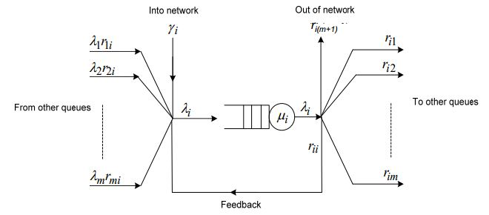

Open Queueing Network(Cont..)
An arbitrary queue i can be represented as:

Slide 20


Open Queueing Network(Cont..)
Here,
Let, 𝛌_{i} be the total mean customer arrival rate to queue i.

Slide 21

Open Queueing Network(Cont..)
The flow conservation equation can be written in matrix vector form as:
This equation relates external arrival rates and routing to determine the total flow at each queue.

Slide 22
Jackson Queueing Network
It is a special class of open queueing network
Properties:
Network of M Queues
There is only one class of customers in the network
The job can leave the network from any node
All outside arrivals to each queuing station in the network must follow a Poisson process.
All service times are exponentially distributed with rate at queue i
The service discipline at all nodes is FCFS.

Slide 23
Jackson Queueing Network(Cont..)
Properties(Cont..):
All external customer arrival processes are Poisson processes with rate γ_{i} at queue i
All queues must have unlimited capacity.
When a job leaves one station, the probability that it will go to another station is independent of its past history and is independent of the location of any other job.
In essence, a Jackson network is a collection of connected M/M/1 or M/M/s queues with known parameters.

Slide 24
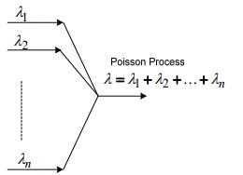
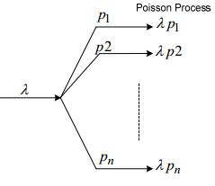
Open Jackson Network
Merging of independent Poisson processes is Poisson with rate equal to the sum of the individual rates.
The departure process of an M/M/1 or M/M/s queue is Poisson with rate equal to input rate of the queue 𝛌.
Probabilistic splitting of a Poisson process results in a Poisson process.
Mean delays at each node can be added to determine mean system(Network) delay.

Slide 25
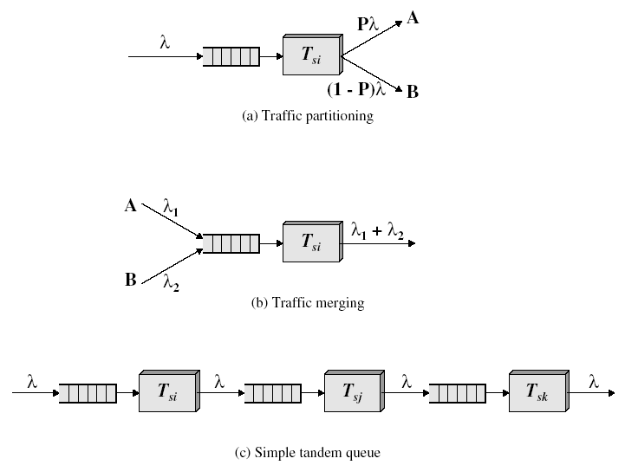
Open Jackson Network(Cont..)

Slide 26
Computation of Input rate
Let,
γ_{i} = external arrival rate to station i = 1, . . . , k
P_{ij} = probability of going from station i to j in network
𝛌 _{i} = total input to station i
In steady state there must be flow balance at each station.
The flow conservation equation or input equation is:
λ_{i} = γ_{i} + Σ P_{mi} λ_{m} , i = 1, . . . , k

Slide 27


Jackson’s Theorem
If in an open network (𝛌_{i} < µ_{i} ) holds for all queues i=1,…,M then the arrival rate 𝛌_{i} can be computed by:
The steady-state probability of the network can be expressed as the product of the state probabilities of the individual queues.
The nodes of the network can be considered as independent M/M/1 or M/M/s queues with arrival rate 𝛌_{i} and service rate µ_{i} .

Slide 28

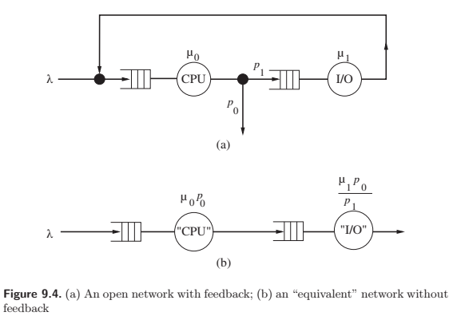









Conversion of a Feed Back Network to Feed Forward Network
W=
For, M/M/1

Slide 29
Jackson’s Queueing Network(Example)
Problem:
A high performance computation center is composed of 3 work stations comprising: (1) input processors, (2) central computers, and (3) a print center.
All jobs submitted must first pass through an input processor for error checking before moving on to a central processor -> 80% go through and 20% are rejected.
Of the jobs that pass through the central processor, 40% are routed to a printer.
Jobs arrive randomly at the computation center at an average rate of 10/min which is a poisson arrival. To handle the load, each station may have several parallel processors.

Slide 30
Jackson’s Queueing Network(Example)
Problem(Cont..):
The time for the three steps have exponential distributions with mean service time as follows: 10 seconds for an input processor, 3 seconds for a central processor and 70 seconds for a print processor. All queues are assumed to have unlimited capacity.
PrP
IOP
PrP
:
:
:
:
μP
IOP
PrP
PrP

Slide 31
Jackson’s Queueing Network(Example)
Problem(Cont..):
PrP
IOP
PrP
:
:
:
:
μP
IOP
PrP
PrP
Goal
Model system as a Jackson network. Find the minimum number of processors of each type and compute the average time require for a job to pass through the system.

Slide 32
Jackson’s Queueing Network(Example)
Solution:
Here, k = 3, 𝛌 = 10, p₁₂ = 0.8, p₂₃ = 0.4
We get, λ₁ = 10
λ₂ = 0.8λ₁ = 8
λ₃ = 0.4λ₂ = 3.2

Slide 33
Jackson’s Queueing Network(Example)
Solution(Cont..):
Input
Central
System measure
Printer
processor
processor
External arrival rate, γ_{i}
10/min
0
0
Total arrival rate, λ_{i}
10/min
8/min
3.2/min
Service rate, μ_{i}
6/min
20/min
0.857/min
Minimum channels, s_{i}
2
1
4
Traffic intensity, ρ_{i}
0.833
0.400
0.933

Slide 34
Jackson’s Queueing Network(Example)
Solution(Cont..):
 | ρ | π₀
Input processor (M/M/2) | 0.833 | 10.976⁻¹ = 0.09
Central Processor (M/M/1) | 0.40 | 0.6
Printer (M/M/4) | 0.933 | ≈141⁻¹

Slide 35



Jackson’s Queueing Network(Example)
Solution(Cont..):

Slide 36
Jackson’s Queueing Network(Example)
Solution(Cont..):
Input
Central
Printer
Measure
processor
processor
station
Total
Model
M/M/2
M/M/1
M/M/4
L_{q}
3.788
0.267
12.023
16.077
W_{q}
0.379
0.033
3.757
4.169
L_{s}
1.667
0.400
3.734
5.801
W_{s}
0.167
0.050
1.167
1.384

Slide 37
Jackson’s Queueing Network(Example)
Solution(Cont..):
L = L_{q} + L_{s} = 16.077 + 5.801 = 21.878 jobs
W = L / λ = 21.878 / 10 = 2.19 mins

Slide 38
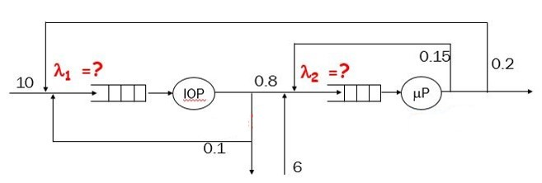
Jackson’s Queueing Network(Example)
Problem:

Slide 39

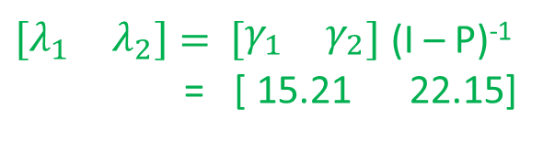
Jackson’s Queueing Network(Example)
Solution:
γ$= \left[\begin{matrix}γ_{1} & γ_{2}\end{matrix}\right]$
λ₁ = 10 + 0.1λ₁ + 0.2λ₂
λ₂ = 6 + 0.8λ₁ + 0.15λ₂
Solves to arrivals are:
λ₁ ≈ 15.21
λ₂ ≈ 22.15
$\left[\begin{matrix}λ_{1} & λ_{2}\end{matrix}\right]=$ $\left[\begin{matrix}γ_{1} & γ_{2}\end{matrix}\right]$ (I – P)⁻¹
= [ 15.21 22.15]

Slide 40
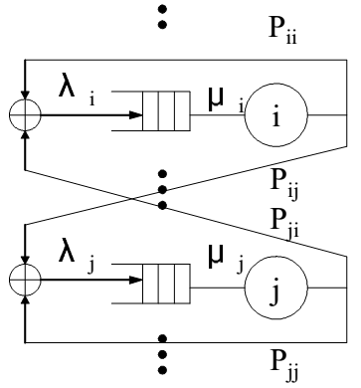
Closed Queueing Network
Fixed population of jobs circulate continuously and never leave.
No arrivals from outside and no departures from the network is allowed.
Since the number of jobs in the system is always constant, the distribution of jobs at different servers cannot be independent.
Simplest case, K customers circulating among m queues
Each queue i has a server with exponentially
distributed service time μ_{i}
P_{ij} be the routing probability from Q_{i} to Q_{m}

Slide 41


Closed Queueing Network(Cont..)
State of network at time t defined by
n =
or simply, = (n₁, n₂, …, n_{m})
It is a m dimensional Markov Process.
The state space S is determined by

Slide 42
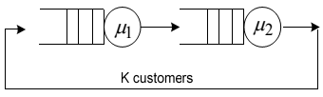
Closed Queueing Network(Cont..)
For example, M = 2, K = 3
(n1, n2) state diagram is:
Gordon and Newell (1967) showed that any arbitrary closed networks of m server queues with exponentially distributed service times also have a product form solution.
μ₂
μ₂
μ₂
0,3
1,2
2,1
3,0
μ₁
μ₁
μ₁

Slide 43

Closed Queueing Network(Cont..)
The solution of the flow balance equation is:
G(K, m) is a normalization constant so that
Given by:
Where

Slide 44
Closed Queueing Network(Cont..)
In order to determine G(K, m) we need to find λ_{i} ; for all i
Flow conservation equation for closed queueing network is:
Same as open network case without external arrivals or departures.
This equation have no unique solution. Fortunately, it turns out that we can use any solution to help us get steady-state probabilities.

Slide 45

Closed Queueing Network(Cont..)
For example, consider the tandem queue model with K = 3 and m = 2. with μ₁ = 1 and μ₂ = 2.
P₁₂ = P₂₁ = 1 and λ₁= λ₂
State space S = { (0,3), (1,2), (2,1), (3,0) }
G(K, m) = G(3,2) =
Choosing λ₁ = 1 λ₂ = 1 ρ₁ = 1 , ρ₂ = 0.5
G(3,2) = 1.875

Slide 46
Closed Queueing Network(Cont..)
Flow balance equations are:

Slide 47
Closed Queueing Network(Cont..)
Drawbacks:
The computation of G( K, m) is difficult when the state space become large.
For a closed network of m queues with K customers the number of states is given by:
For even small networks, this is large. For example, K = 9 and m = 2 there are 3,628,800 states.
So this direct computation of G(K,m) is very tedious for large state space.
No. of States =

Slide 48
References
Slides from internet sources
Only Slide is needed to study.

Slide 49


